Slide 1
Bank Management System
Name:- Abhishek Sharma
Semester:- II
Class:- F.Y.M.C.A
Roll no:- 151
Subject:- Project(Python)
Guide:- Anju Ma’am
College:- Siddhanth Institute of Computer Application.

Slide 2
Introduction
The “Bank Account Management System” project is a model Internet Banking Site.
This site enables the customers to perform the basic banking transactions just like operating a ATM anywhere.
The system provides the access to the customer to create an account, deposit/withdraw the cash from his account, also to view reports of all accounts present.
The brick-and-mortar structure of the traditional banking gets converted into a click and portal model, thereby giving a concept of virtual banking a real shape
E-banking facilitates banking transactions by customers round the clock globally.

Slide 3
Objective
Customer Satisfaction: Client can do his operations comfortably without any risk or losing of his privacy. Our software will perform and fulfill all the tasks that any customer would desire.
Saving Customer Time: Client doesn't need to go to the bank to do small operation.
Protecting the Customer: It helps the customer to be satisfied and comfortable in his choices, this protection contains customer’s account, money and his privacy.
Transferring Money: Help client transferring money to/or another bank or country.

Slide 4
Scope Of Work
The Traditional way of maintaining details of a user in a bank was to enter the details and record them.
Every time the user needs to perform some transactions he has to go to bank and perform the necessary actions, which may not be so feasible all the time.
The project gives real life understanding of Online Banking System and activities performed by various roles in the supply chain. Here, we provide automation for banking system through Internet.
The project gives real life understanding of Online Banking System and activities performed by various roles in the supply chain

Slide 5
Existing System
Existing System is time consuming.
Customer have to travel to there respective bank branches to executed tasks.
24/7 is not available.
Long hour process.

Slide 6
SYSTEM REQUIREMENTS
1.
Hardware Requirements
Processor : Intel Pentium IV 2.4 GHZ or above
Clock speed : 700 MHZ
System bus
: 32
bits PCI Ethernet card
RAM : 512MB of RAM
HDD : 20 GB or higher
2. Software Requirements
OS :
MS WINDOWS XP/2000(clien
t/server)
User Inter
face :
Tkinter
Programming Language : Python
Web Applications :Tkinter
IDE/Workbench :
Visual studio code
Database :
SQLite3
Server Deployment
:
DB Browser

Slide 7
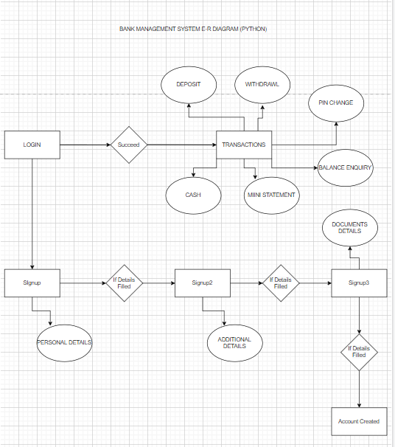
E-R Diagram

Slide 8
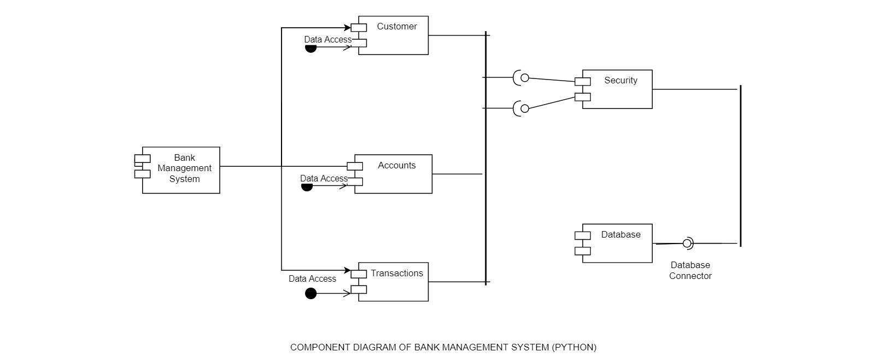
Component Diagram

Slide 9
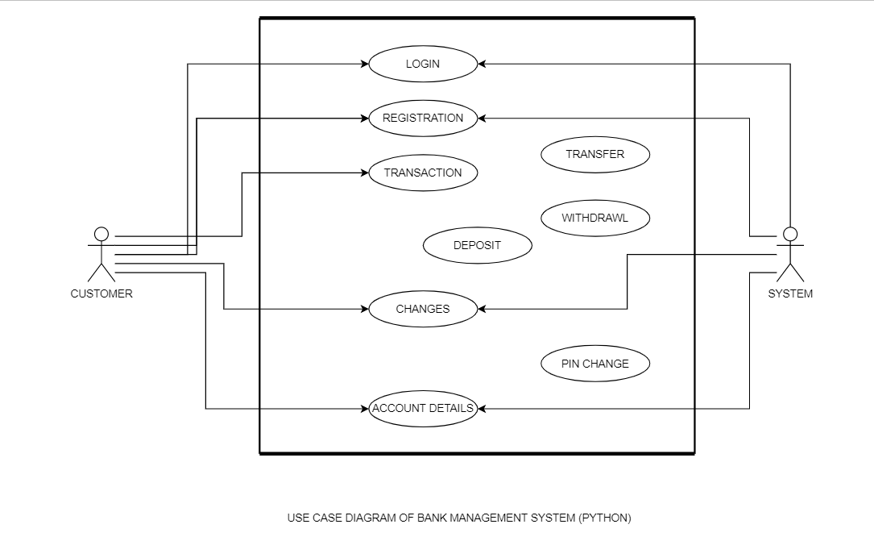
Use Case Diagram

Slide 10
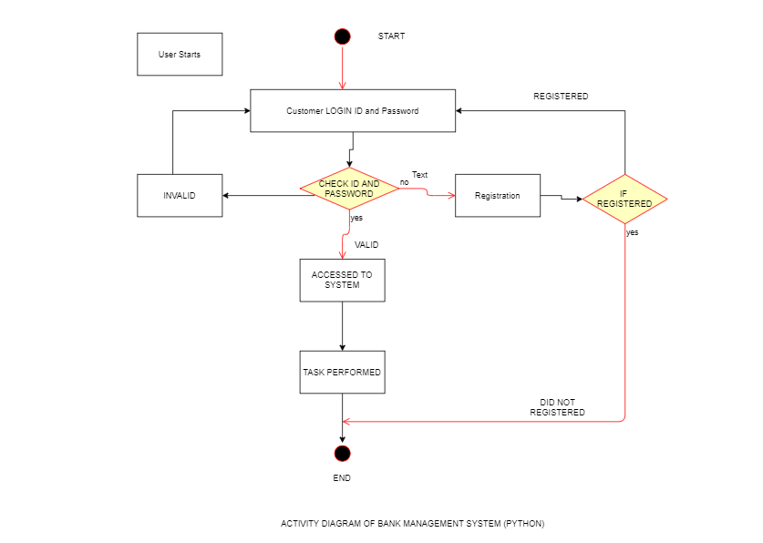
Activity Diagram

Slide 11
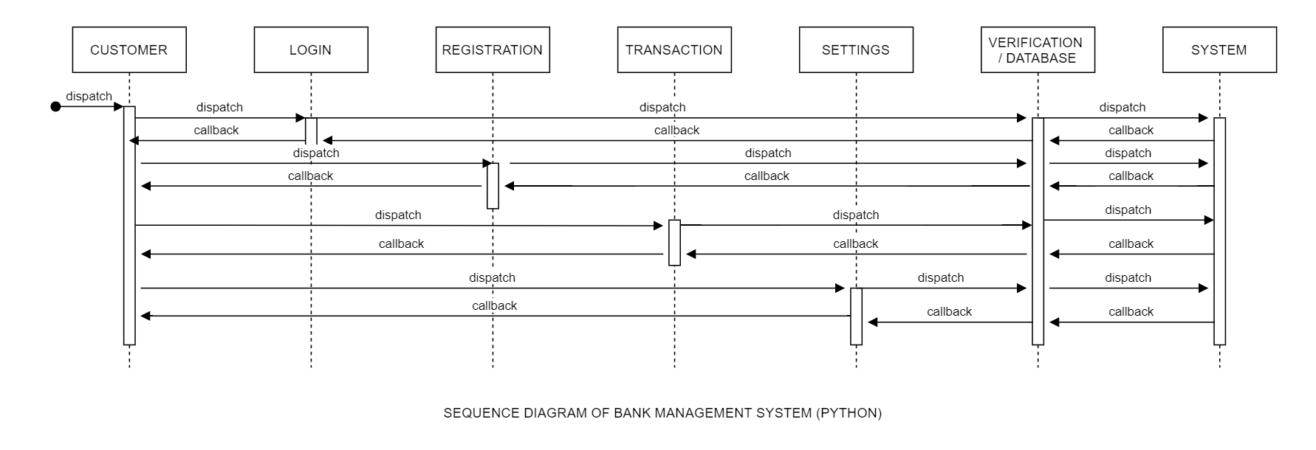
Sequence Diagram

Slide 12
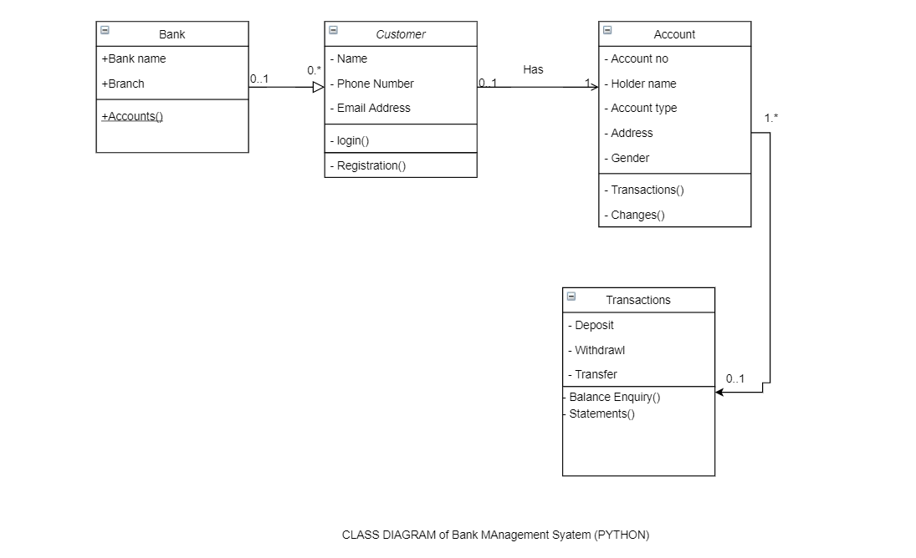
Class Diagram

Slide 13
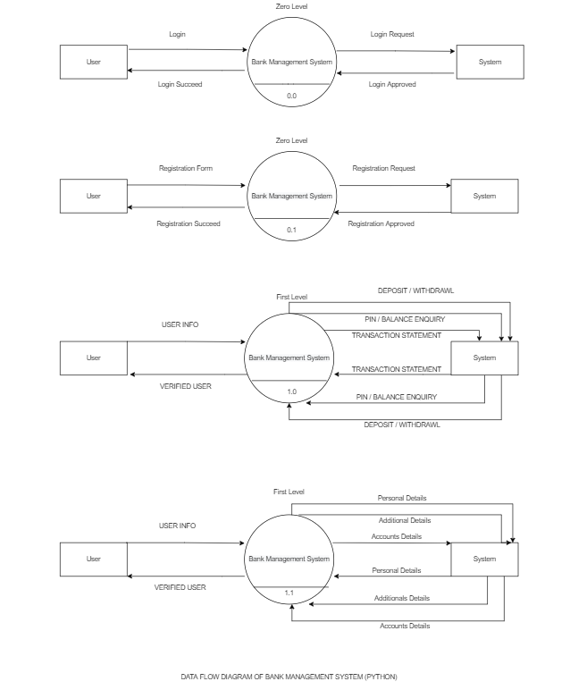
DFD Diagram

Slide 14
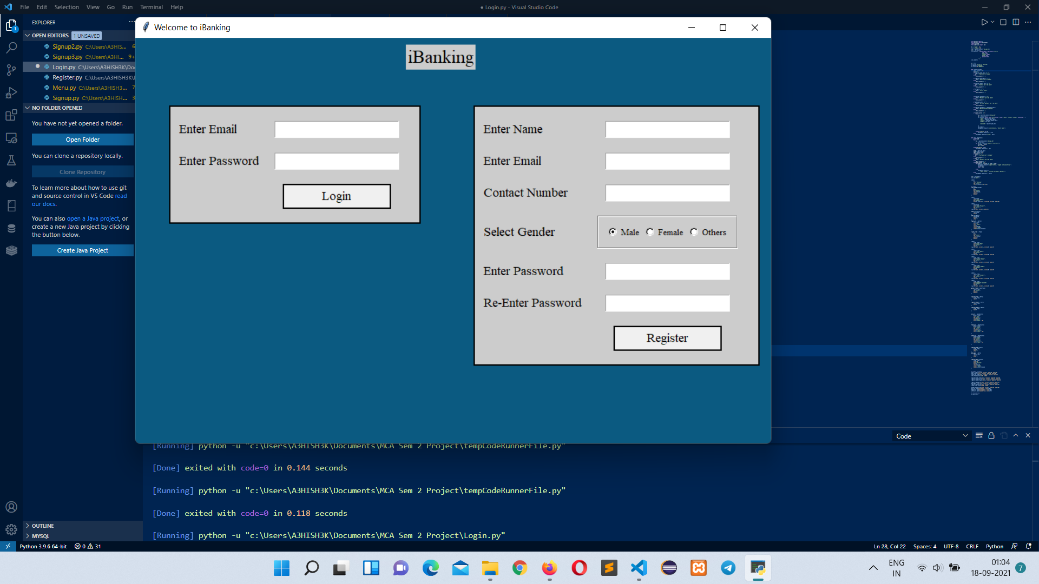
Project Screenshots

Slide 15
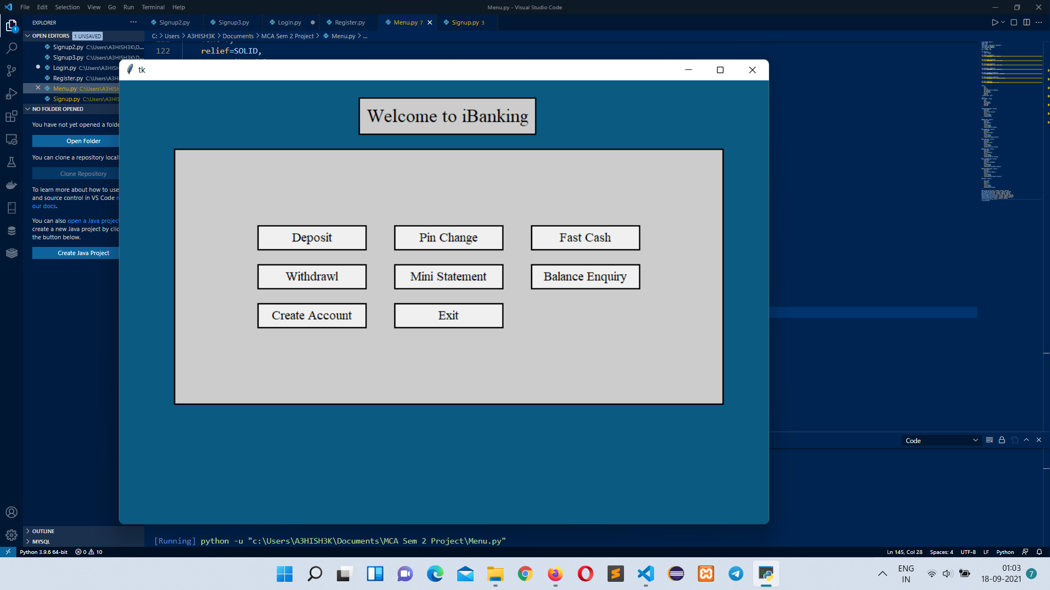
Project Screenshots

Slide 16
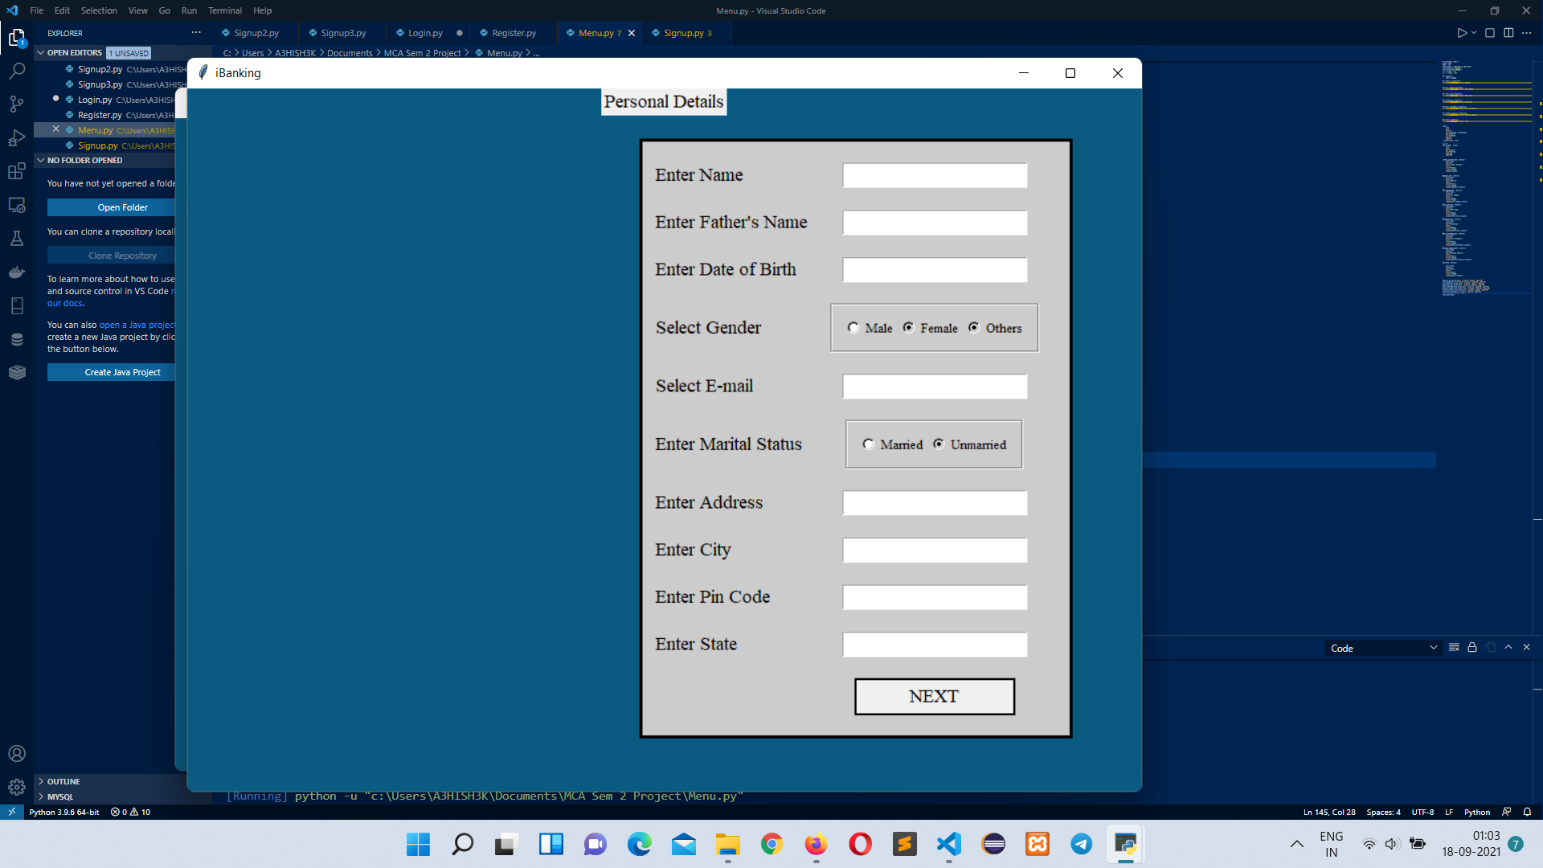
Project Screenshots

Slide 17
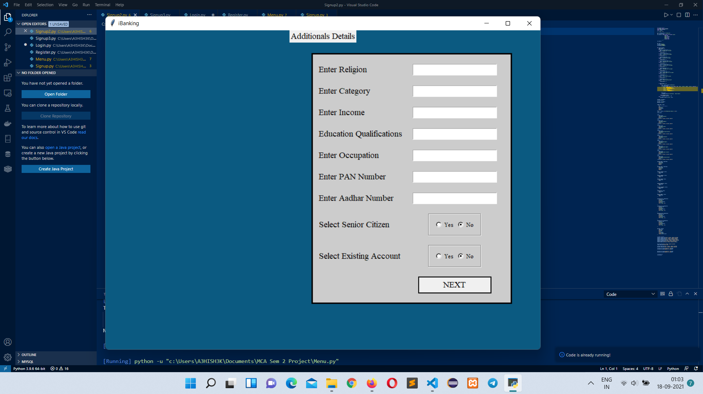
Project Screenshots

Slide 18
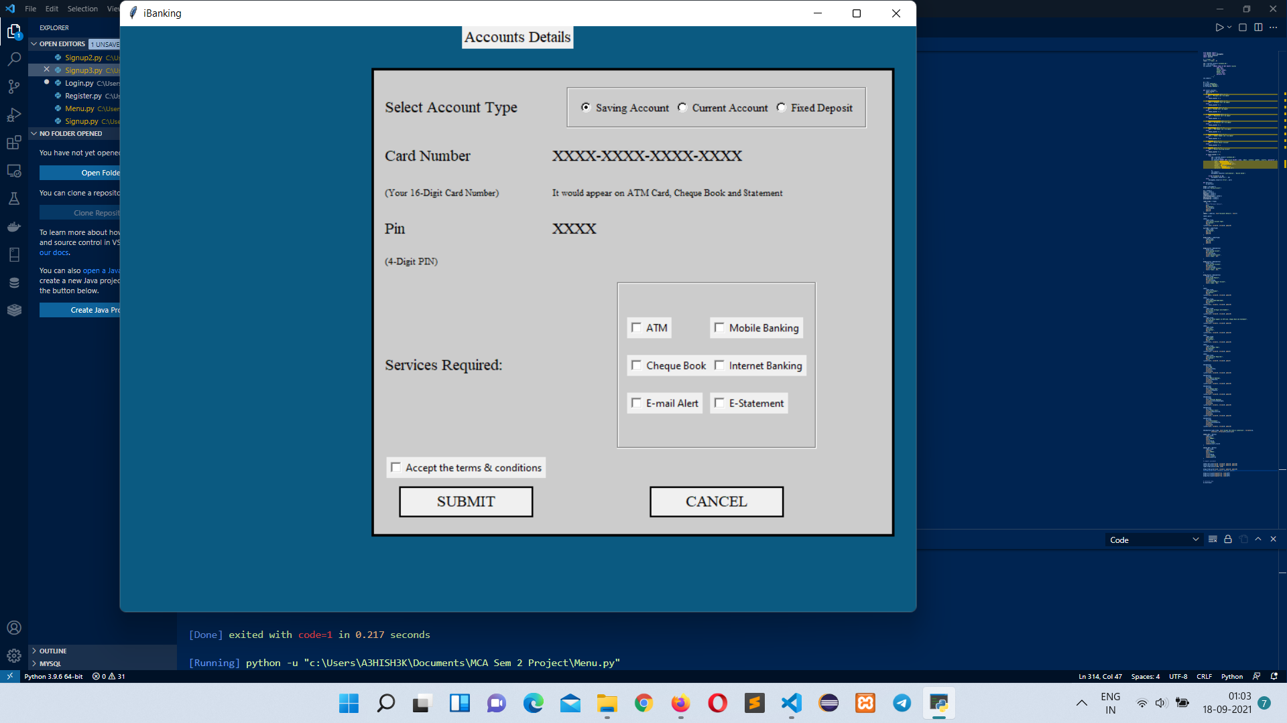
Project Screenshots

Slide 19
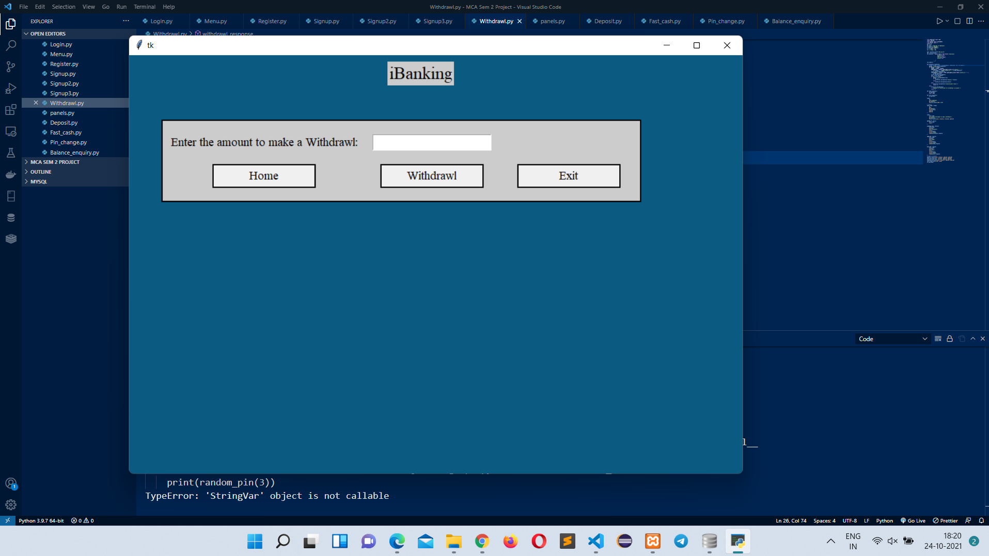
Project Screenshots

Slide 20
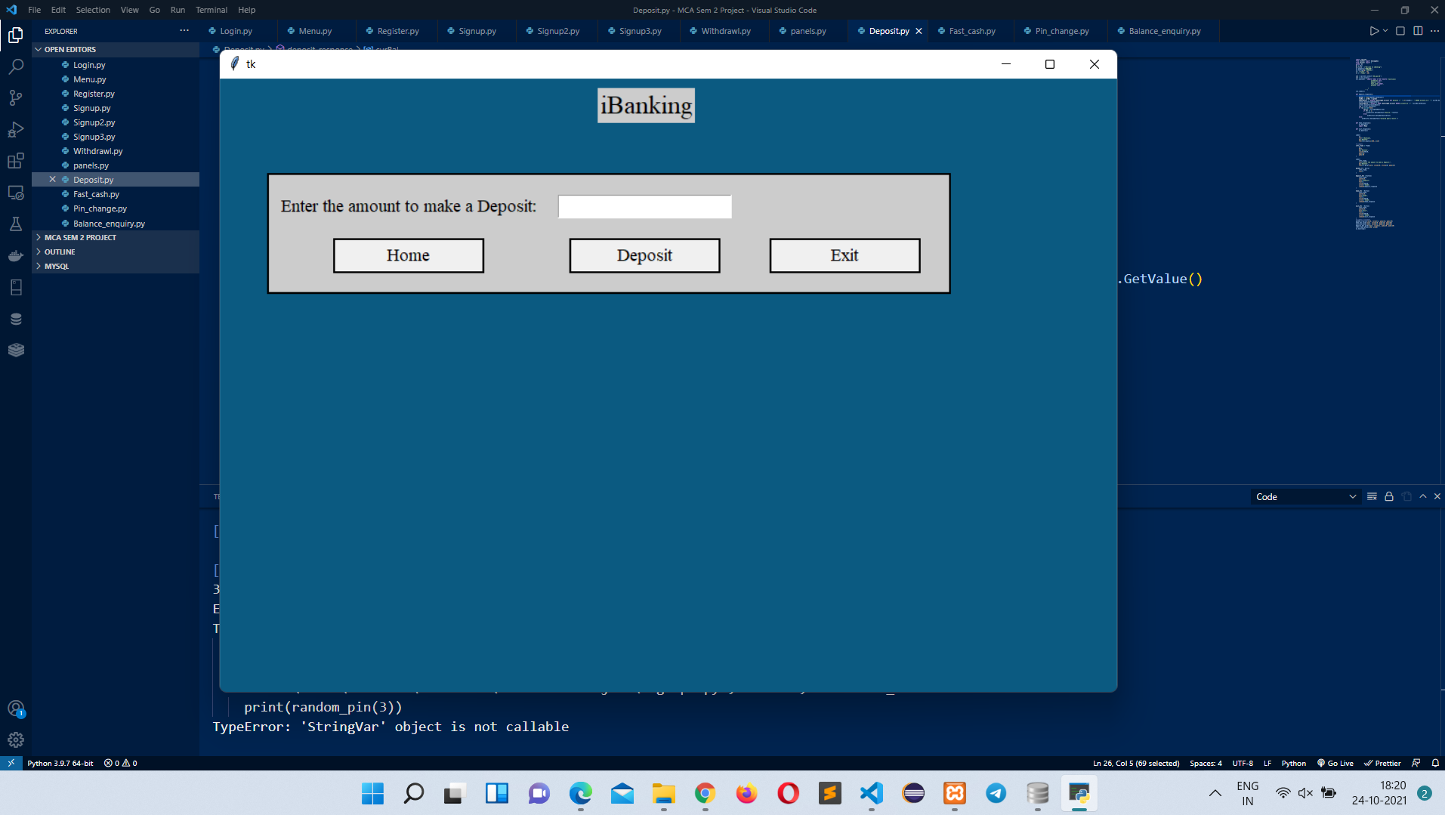
Project Screenshots

Slide 21
Thank You

